Slide 1
TO BE FORMS-AM,IS,ARE
Interrogative Forms [questions]

Slide 2
TO BE FORMS-AM,IS,ARE
A QUICK REVIEW
AFFIRMATIVE SENTENCES NEGATIVE SENTENCES
I am a doctor. I am not a doctor.
She is a graduate. She is not a graduate.
He is hardworking. He is not hardworking.
The clock is working. The clock is not working.
The book is useful. The book is not useful.
They are confident. They are not confident.
We are at home. We are not at home.
The students are active. The students are not active.
She is well. She is not well.

Slide 3
TO BE FORMS-AM,IS,ARE
Interrogative Forms –Yes/No Questions
Am I….?
Is she…..?
Is he…..?
Is it……?
Are you….?
Are we…..?
Are they…?

Slide 4
TO BE FORMS-AM,IS,ARE
Interrogative Forms-Yes/No Questions
Am I a teacher? Yes, I am a teacher. or No,I am not a teacher.
Is she happy? Yes ,she is happy. or No, she is not happy.
Is he a graduate? Yes , he is a graduate. or No, he is not a graduate.
Is it 10 o’clock? Yes , it is 10 o’clock. or No, it is not 10 o’clock.
Are we doctors? Yes we are doctors. or No,we are not doctors.
Are they at home? Yes,they are at home. or No,they are not at home.
Are you tired? Yes, I am tired. or No,I am not tired.

Slide 5

TO BE FORMS-AM,IS,ARE
Interrogative Forms-Yes/No Questions
Is he your son?
Yes he is my son.
No he is not my son.He is my nephew.

Slide 6

TO BE FORMS-AM,IS,ARE
Interrogative Forms-Yes/No Questions
Is it your phone?
Yes it is my phone.
No it is not my phone. It is my brother’s.

Slide 7
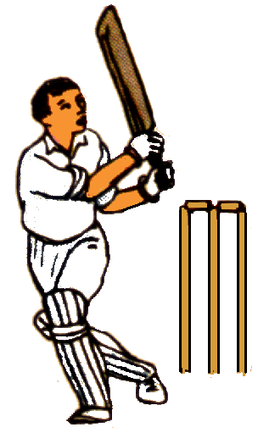
TO BE FORMS-AM,IS,ARE
Interrogative Forms-Yes/No Questions
Are you interested in cricket?
Yes I am interested in cricket.
No I am not interested in cricket.
I am interested in football.

Slide 8
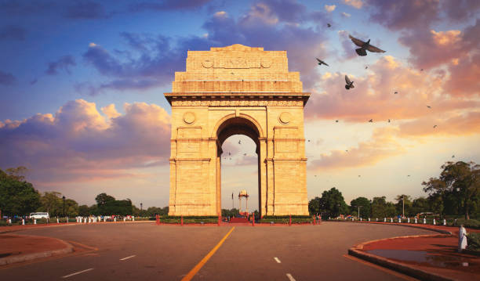
TO BE FORMS-AM,IS,ARE
Interrogative Forms-Yes/No Questions
Are they from Delhi?
Yes they are from Delhi.
No they are not from Delhi.
They are from Hyderabad.

Slide 9
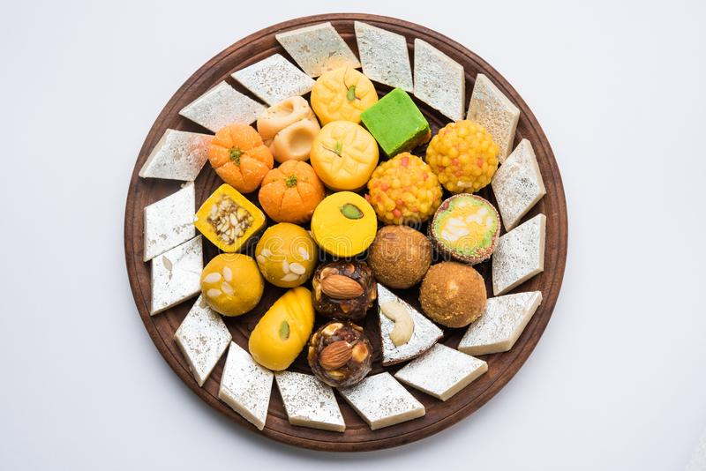
TO BE FORMS-AM,IS,ARE
Interrogative Forms-Yes/No Questions
Are you fond of sweets?
Yes I am fond of sweets.
No I am not fond of sweets.
I am fond of savouries.

Slide 10

TO BE FORMS-AM,IS,ARE
Interrogative Forms-Yes/No Questions
Is your brother employed?
Yes my brother is employed.
No my brother is not employed.
He is studying.

Slide 11
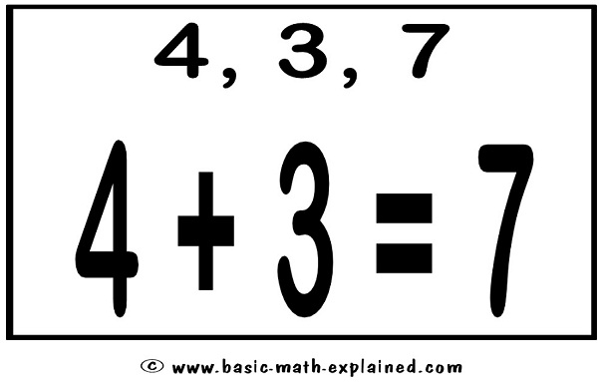
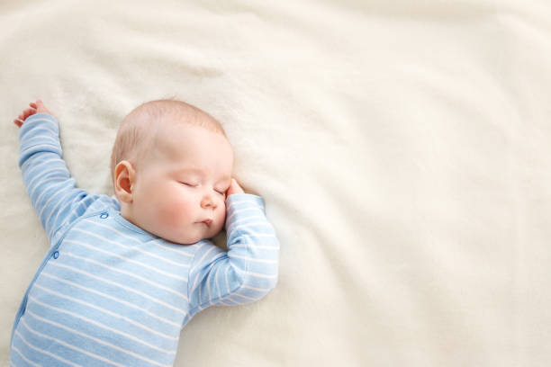

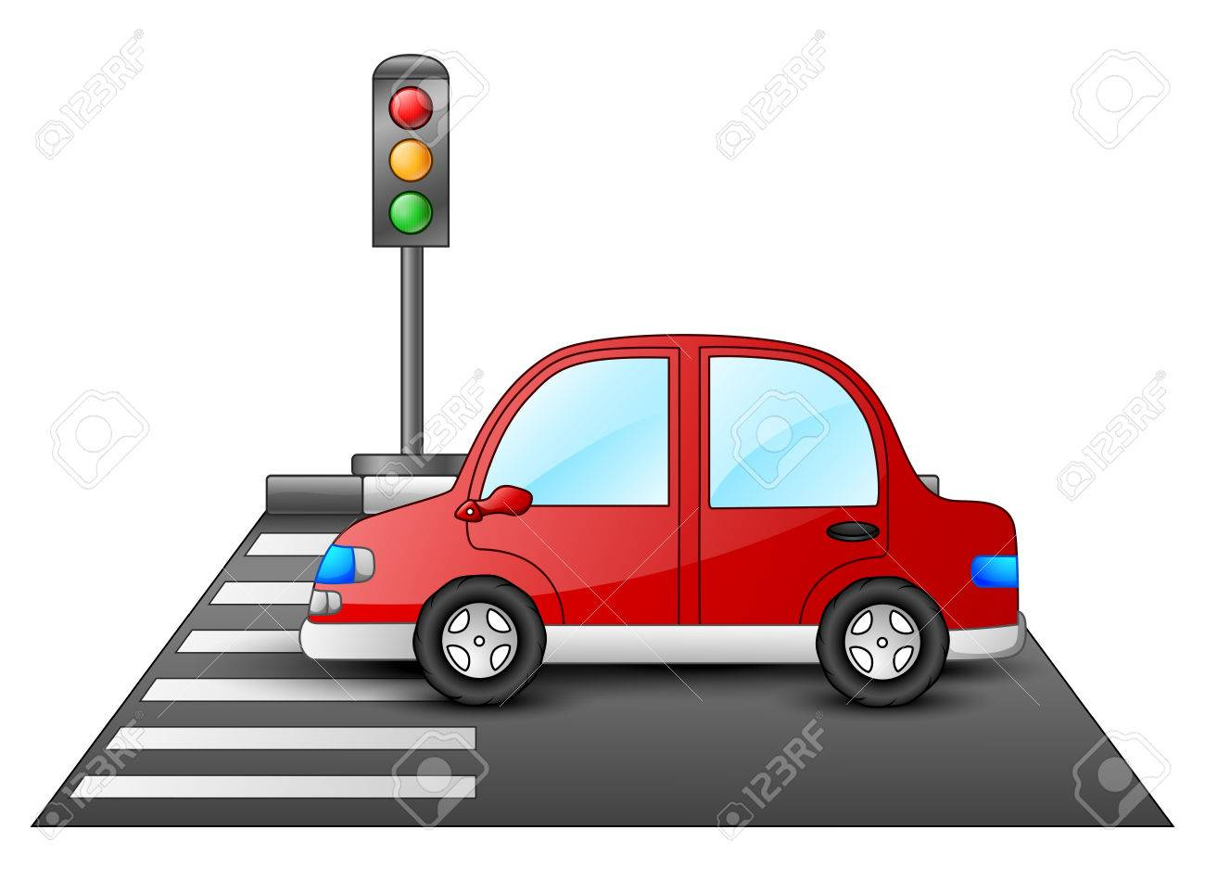
TO BE FORMS-AM,IS,ARE
Interrogative Forms-Yes/No Questions
Is the answer correct?
Yes the answer is correct.
Is the baby asleep?
Yes the baby is asleep.
Is the car at the traffic lights?
Yes the car is at the traffic lights.
Is the manager busy?
Yes the manager is busy.

Slide 12
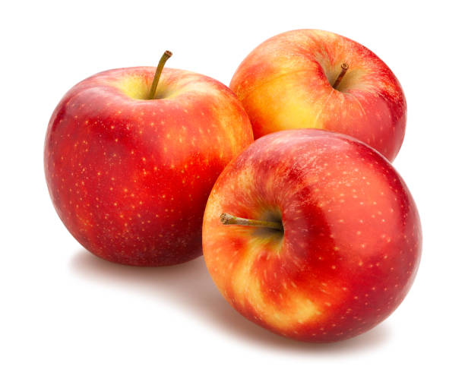
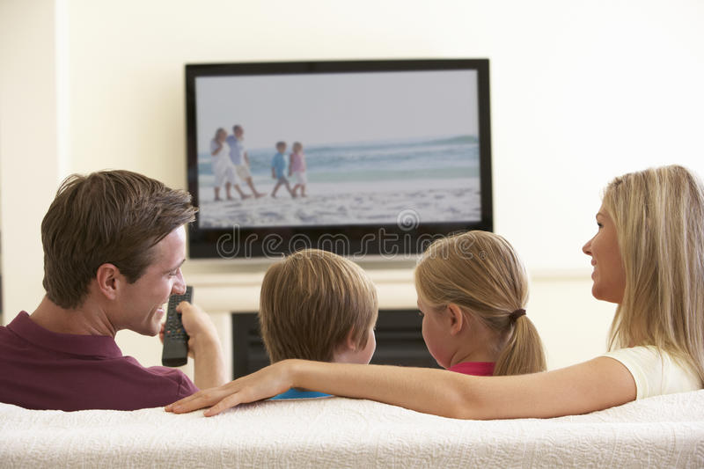


TO BE FORMS-AM,IS,ARE
Interrogative Forms-Yes/No Questions
Are the apples cheap?
No they are not cheap.
They are expensive.
Is the TV show interesting?
No the TV show is not interesting.
The TV show is boring.
Are the shops closed?
No the shops are not closed.
They are open.
Is the queue long?
No the queue is not very long.
It is short.

Slide 13

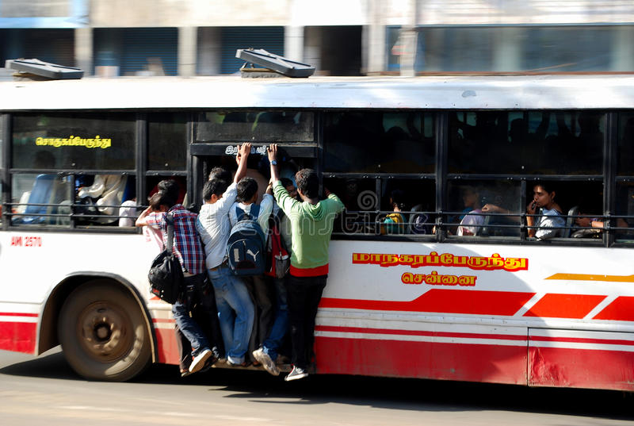
TO BE FORMS-AM,IS,ARE
Interrogative Forms-Yes/No Questions
Are there many books in the library?
Is the bus crowded?

Slide 14
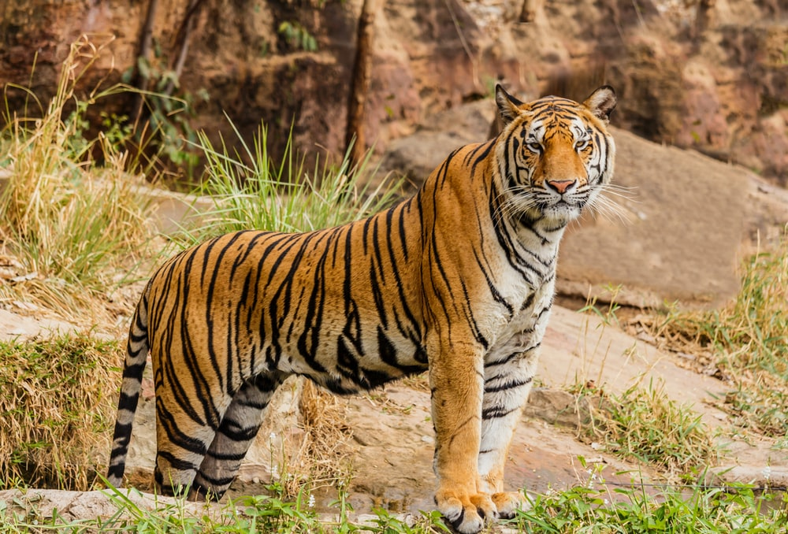

TO BE FORMS-AM,IS,ARE
Interrogative Forms-Yes/No Questions
Is it a lion?
Is it sunny?

Slide 15
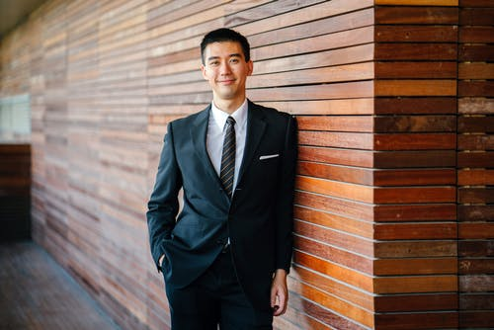
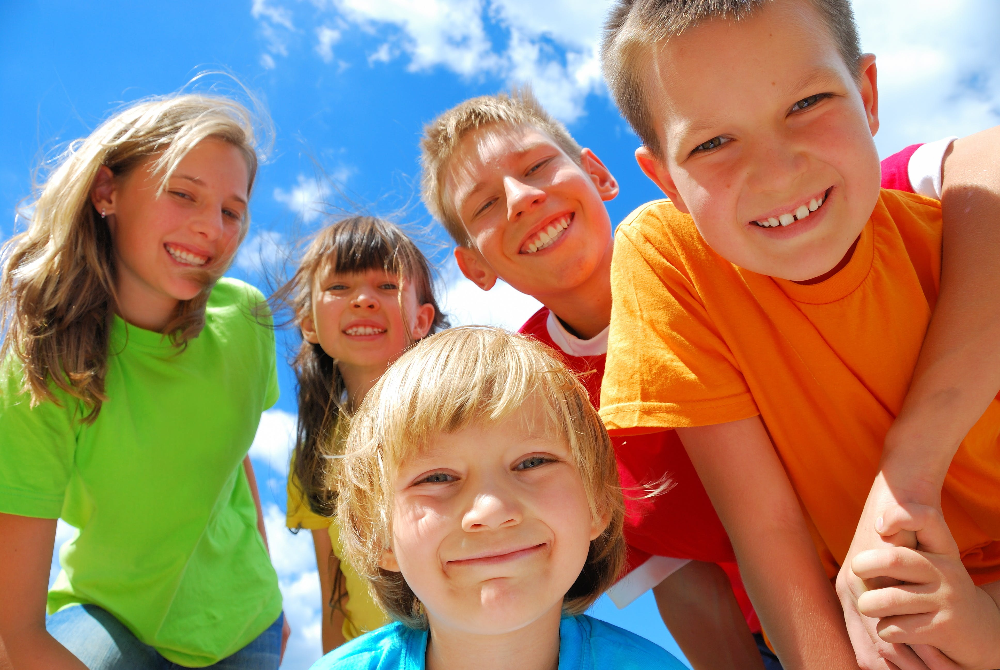
TO BE FORMS-AM,IS,ARE
Interrogative Forms-Yes/No Questions
Are the children happy? Is he a businessman?

Slide 16
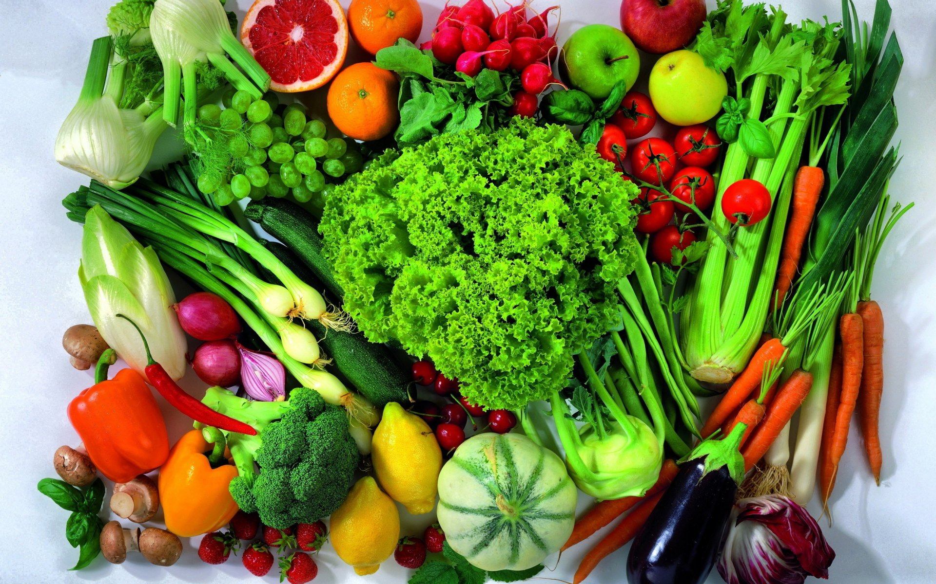
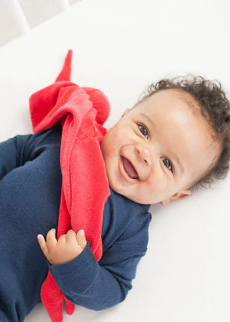
TO BE FORMS-AM,IS,ARE
Interrogative Forms-Yes/No Questions
Are the vegetables fresh? Is the baby asleep?

Slide 17
TO BE FORMS-AM,IS,ARE
Make Yes/No Questions
Yes, it is a holiday.
No, it is not my book.
Yes, my house is far from here.
Yes, my father is a farmer.
Yes, there are many books in the library.
Yes, the oranges are sweet.
No ,the doctor is not available now.
Yes, I am from Hyderabad.
Yes ,this book is available in the store.
Yes I am busy.
Yes they are my cousins.
Yes, the movie is nice.

Slide 18
TO BE FORMS-AM,IS,ARE
Answer Yes/No Questions {Practice}
Are you employed? Is it true? Is the food tasty?
ls the weather nice today? Is it raining now? Are there books in the library?
Is your dress new? Are you hungry? Are you beautiful?
Are you interested in music? Are your parents with you? Is it 12 o’clock?
Is this lesson useful? Are you ambitious? Is your hometown well-developed?
Is there a garden in your house? Are you a good cook? Is the book interesting?
Is your house big? Are you a good singer? Is your father a farmer?
Are you afraid of dogs? Is your mother tongue Hindi? Are your parents educated?
Are you an only child? Is English easy? Are you married?

Slide 19
TO BE FORMS-AM,IS,ARE
Interrogative Forms-Yes/No Questions

Slide 20
TO BE FORMS-AM,IS,ARE
Interrogative Forms-Yes/No Questions

Slide 21
TO BE FORMS-AM,IS,ARE
Interrogative Forms-Yes/No Questions

Slide 22
TO BE FORMS-AM,IS,ARE
Interrogative Forms

